Slide 1
Database Design and Implementation
Task6

Slide 2

ROAD STATE/ROAD SIGN MOBILE APP
GROUP 22
Course Instructor: DR NKEMENI VALERY

Slide 3
Table of contents
01
03
02
04
05
06
07
08
Introduction
Data Elements
ER Diagram
Conceptual
Design
Database Implementation
Backend Implementation
Database connected to backend
Conclusion

Slide 4
01
Introduction

Slide 5
Introduction
Motosure's database, built on Firebase Firestore, efficiently stores and manages user data, road hazard reports, alerts, road signs, and preferences to enhance road safety through real-time notifications. The cloud-based NoSQL system ensures scalability, real-time synchronization, and offline access, supporting instant hazard reporting and personalized alerts. This design is critical for improving safety across urban areas with varying network conditions.

Slide 6
02
Data Elements

Slide 7
Data Elements
CORE DATA ENTITIES
USER
USER PREFERENCE
ROAD REPORT
ALERT
ROAD SIGN
ROUTES

Slide 8
03
Conceptual Design

Slide 9
Conceptual Design
Database Requirements
REAL-TIME SINCHRONIZATION
OFFLINE SUPPORT
SCALABILITY

Slide 10
Conceptual Design
Firebase Firestore Structure
USER COLLECTION
ROAD SIGNS COLLECTION
REPORTS COLLECTION
ALERTS COLLECTION

Slide 11
04
ER Diagrams

Slide 12
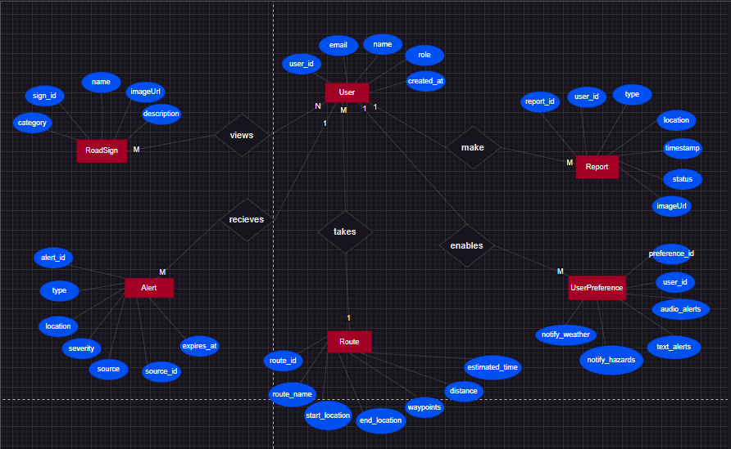
ER Diagram
.

Slide 13
05
Database Implementation

Slide 14
DB Implementation
FIRESTORE SETUP
Security Rules
Collections and Documents
Offline Persistence

Slide 15
06
Connecting Database To Backend

Slide 16
DB Connection-Backend
FIREBASE SERVICE LAYER
BACKEND LOGIC WITH CLOUD FUNCTIONS
DATA FLOW OVERVIEW

Slide 17
07
Conclusion

